Slide 1
PromptCrowd
Solution for Prompt Engineering with Crowdsourcing
23-24 Sem 2 SC4052 <Cloud Computing> Project
N2304863G LEE HEECHAN

Slide 2
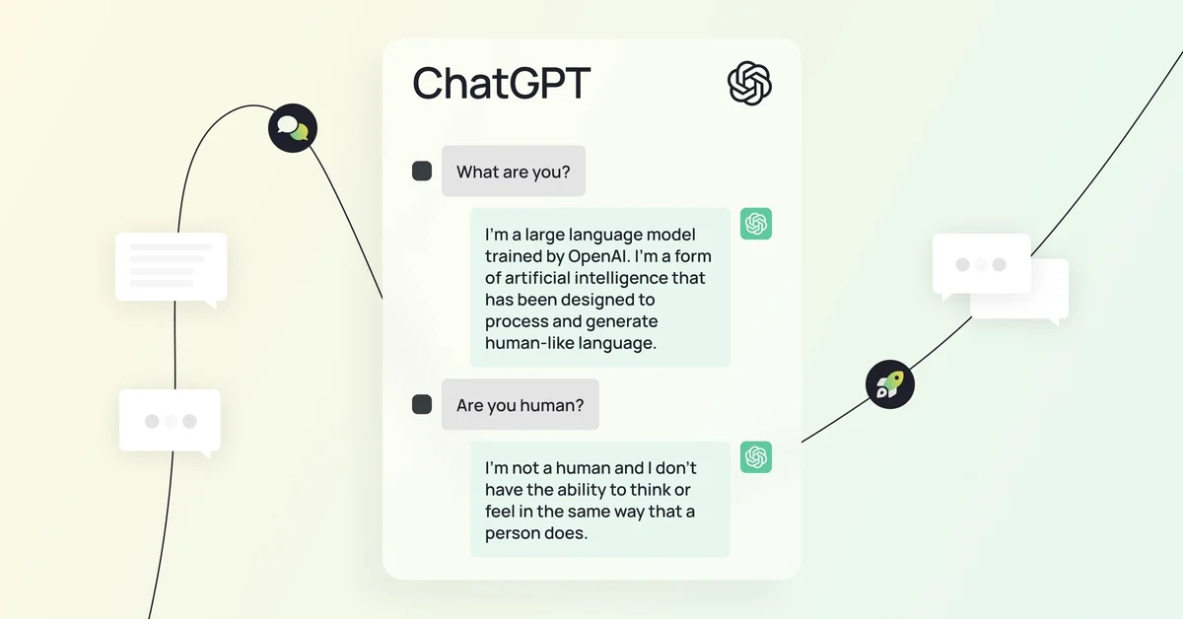
Background - Large Language Model (LLM)
Large Language Models (LLMs) are advanced AI systems trained on vast datasets to understand, generate, and respond to human language.
Models such as GPT4 are famous, and many services based on them are appearing. For example, ChatGPT. Many people are using this ChatGPT to create various values.

Slide 3
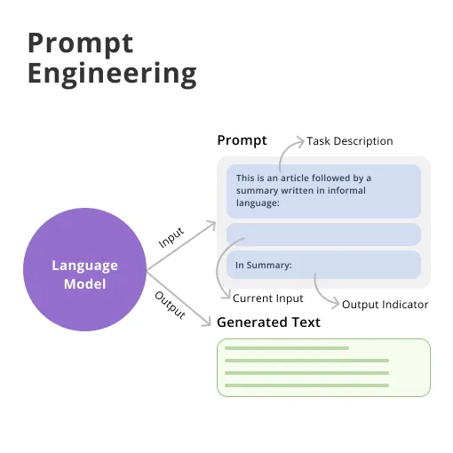
Background - Prompt Engineering
Prompt Engineering is the process of carefully crafting inputs (prompts) to guide the responses of a Large Language Model (LLM).
It's essential for obtaining accurate, relevant, and useful outputs from AI models.

Slide 4
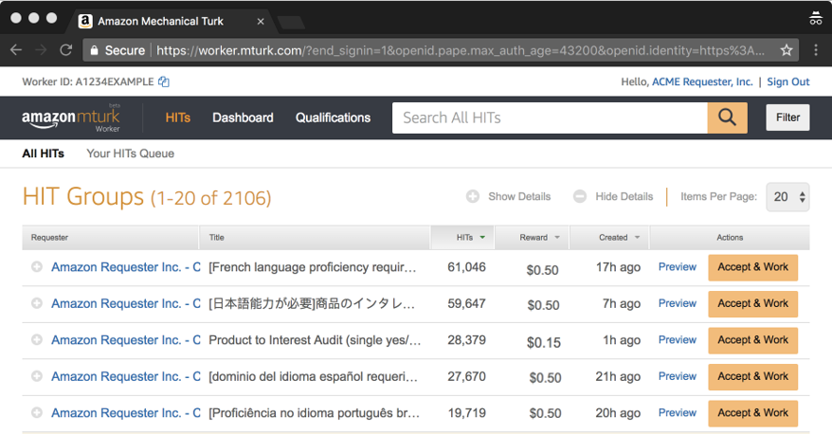
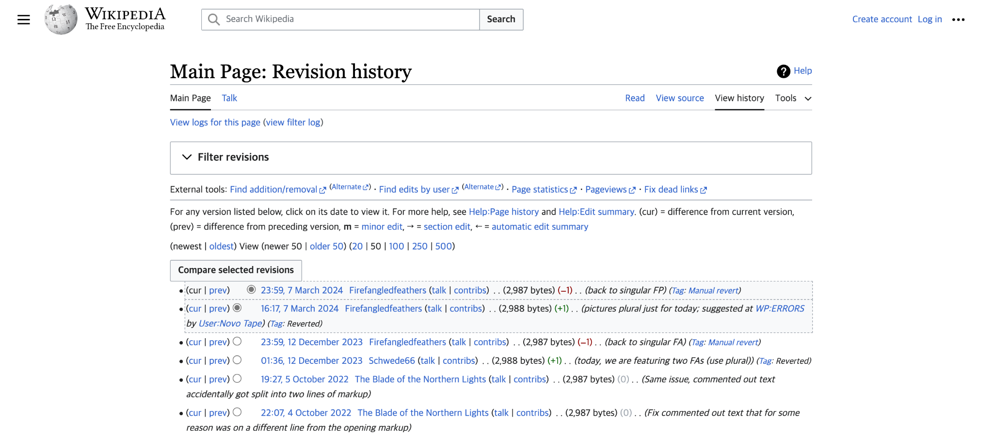
Background - Crowdsourcing
Crowdsourcing is a method of obtaining ideas, services, or content by soliciting contributions from a large group of people, particularly from an online community.
Crowdsourcing offers cost-effective solutions and diverse perspectives, leading to innovative ideas and efficient problem-solving.
It enables rapid scaling for large projects and global participation, enhancing flexibility and community engagement.
Amazon Mechanical Turk (MTurk)
Wikipedia

Slide 5
Problem Statement
The problem that users are undergoing in prompt engineering
Difficult to make LLM to return desired answer because of ambiguity of language
Debugging process requires lots of trials and errors. Difficult to inexperienced people
Why?
Lack of processes or tools for users to identify and optimize prompt statements that effectively guide to tune LLMs towards desired responses.

Slide 6
Problem Statement
The main challenge of this project is
to develop a crowdsourcing solution that makes users to collaboratively identify and refine prompt statements
that enhance the performance and usability of LLMs.

Slide 7
Solution Design
To make good quality of question, user should provide the precise explanation for other users.
So it requires to write example user chat and expected answer.
Post Question
Start to write
answer
Write prompt statements with several tests
Make Answer
New answer posted!
GPT Test
Start to write forking answer based on existing question
Fork

Slide 8
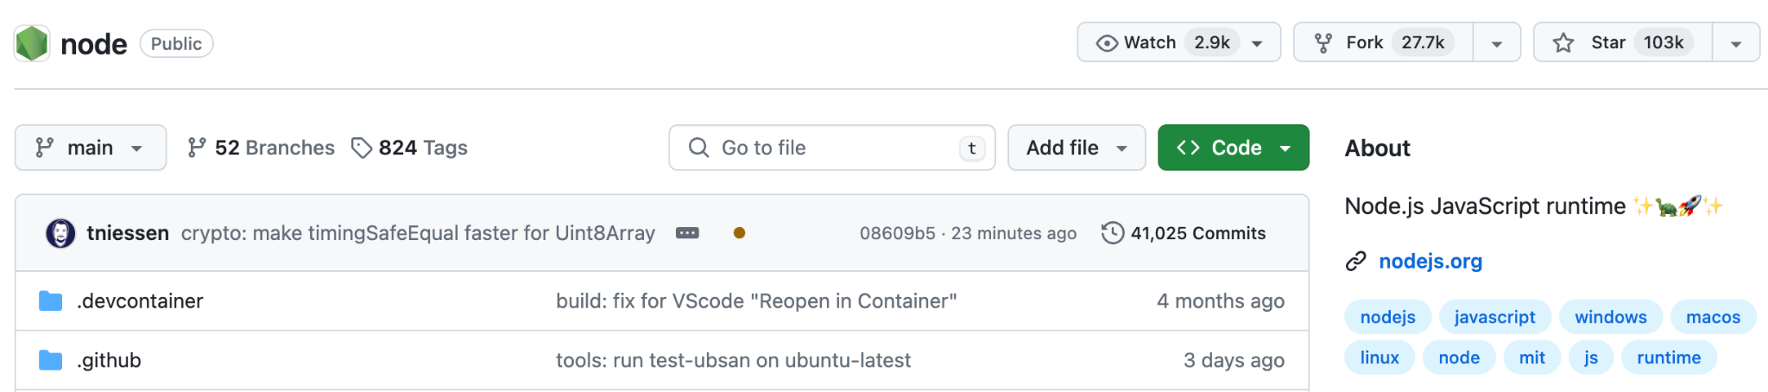
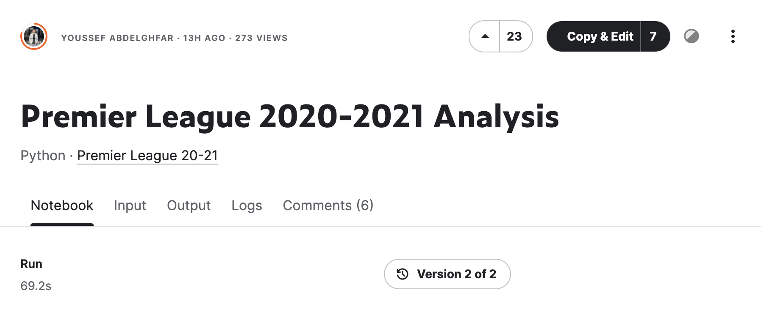
Main Idea: Forking
Prompt engineering needs lots of trials and errors. Subtle changes in prompt wording or LLM parameters can make huge difference of response.
It is believed that user can get better result by forking exist answers and adding their ideas.
This idea is based on ‘fork system’ of several services, such as Github and Kaggle.
Fork button and count of Github
Copy and edit of Kaggle

Slide 9



Implementation Tech Stack
Frontend Web: React.js + TypeScript
Database: Firebase Realtime Database
Deployment: Vercel
Serverless (no need to manage server manually)

Slide 10
Demo
Demo Website: https://prompt-crowd.vercel.app/
Demo Github: https://github.com/Gabul99/PromptCrowd

Slide 11
Demo
Login: There is no register step for this demo. Anyone can enter with their nickname

Slide 12
Demo
New question modal: Users should type title, detail, example user message and expected AI answer.

Slide 13
Demo
New answer and Test: User can make new prompts, adjust the LLM parameters and they can immediately test their prompts by GPT

Slide 14
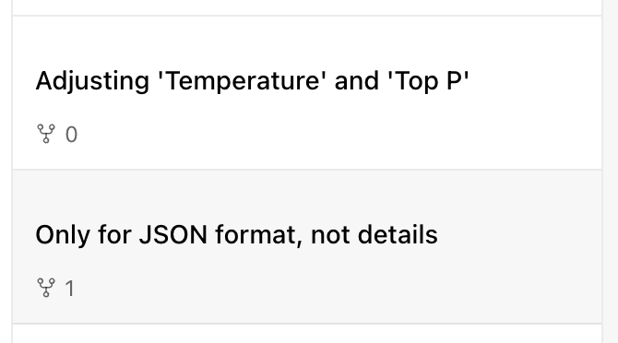
Demo
Fork
Fork count in answer list: This fork count UI means that how many times this answer has been forked. It is expected to play a role like paper citation.

Slide 15
Demo
Fork: Users can fork existing answer. Users can make slight change on existing answer and post it. After posting, the fork count of original answer is increased.

Slide 16
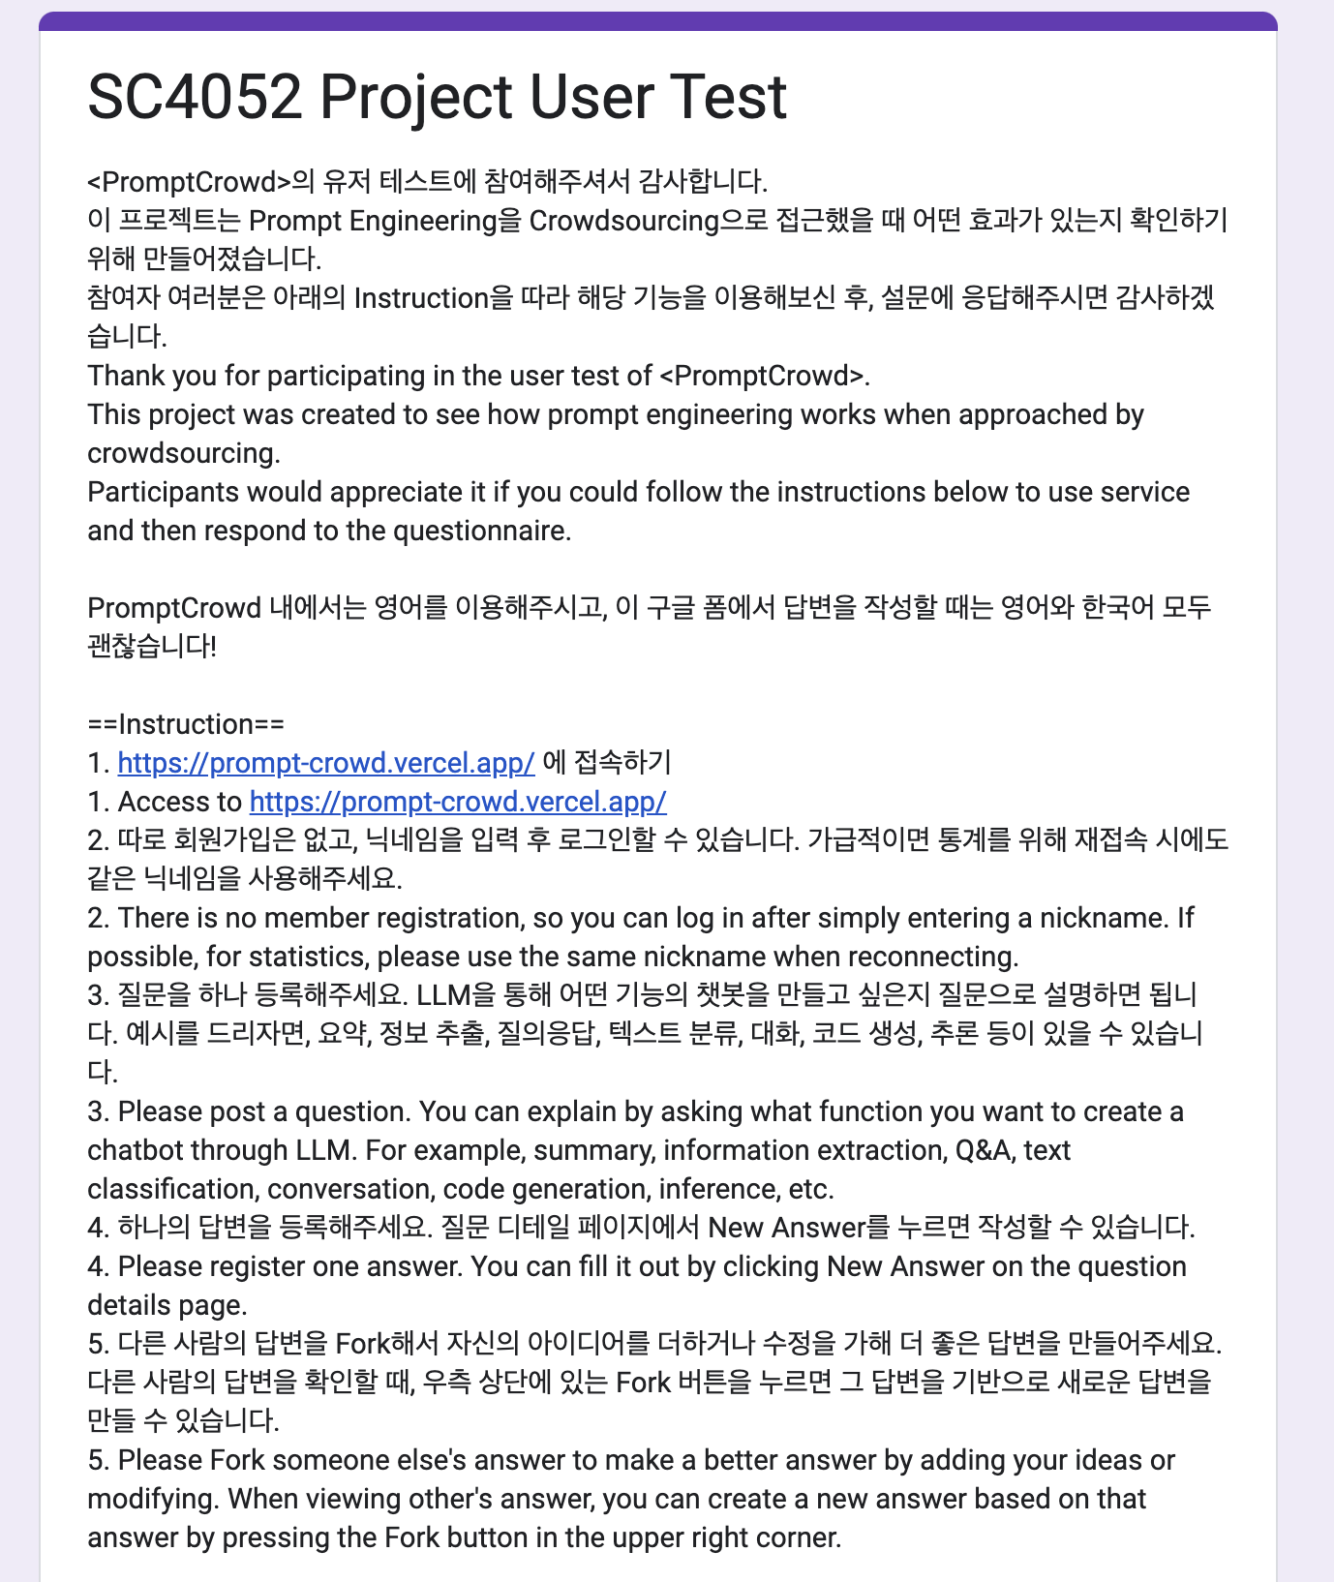
User Test
11 undergraduate / graduate students
March 30th to April 5th (One week)
The google form includes detail instruction for user test and several survey questions.
Instructions for user test (Not strict, just guidance)
1. Access to https://prompt-crowd.vercel.app/
2. There is no member registration, so you can log in after simply entering a nickname. If possible, for statistics, please use the same nickname when reconnecting.
3. Please post a question. You can explain by asking what function you want to create a chatbot through LLM. For example, summary, information extraction, Q&A, text classification, conversation, code generation, inference, etc.
4. Please register one answer. You can fill it out by clicking New Answer on the question details page.
5. Please Fork someone else's answer to make a better answer by adding your ideas or modifying. When viewing other's answer, you can create a new answer based on that answer by pressing the Fork button in the upper right corner.

Slide 17
User Test
Survey Questions
When writing a question, did having you write examples of user messages and expected answers help clarify the question? (1~5 linear scale)
2. Was the editor writing the answer intuitive and easily accessible? (1~5 linear scale)
3. What does the fork count value representing how forked the answer is, make an impression on that answer? (Short answer)
4. Was the fork feature easy to recognize? (1~5 linear scale)
5. Do you think the Fork feature helps to make a better answer? (1~5 linear scale)
6. You can check the performance of the prompt with the GPT Test. What is your overall satisfaction with the GPT Test screen? (1~5 linear scale)
7. Do you think this service will help many users use LLM? Please write your opinion. (Short answer)
8. I would appreciate it if you could tell me what I can improve in terms of features or UI/UX. (Short answer)

Slide 18
User Test Analysis
Survey
Participants
Created
Questions
Created
Answers
Answers
Created by Fork
Participants
11
7
8
13
5

Slide 19
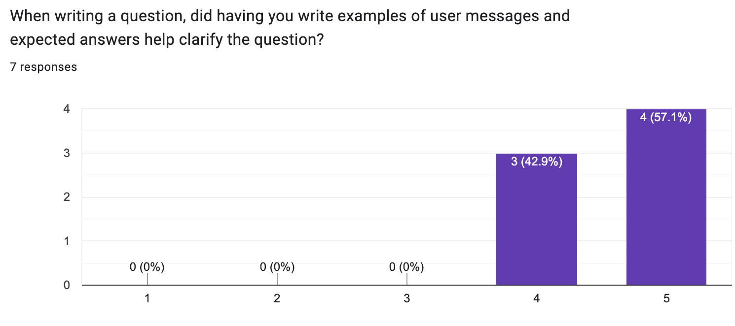
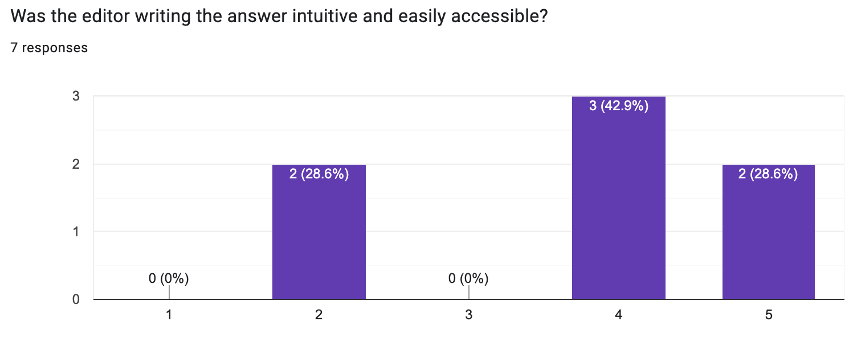
User Test Analysis
Q1. Clarify of Question
Q2. UI/UX of Editor of Answer

Slide 20
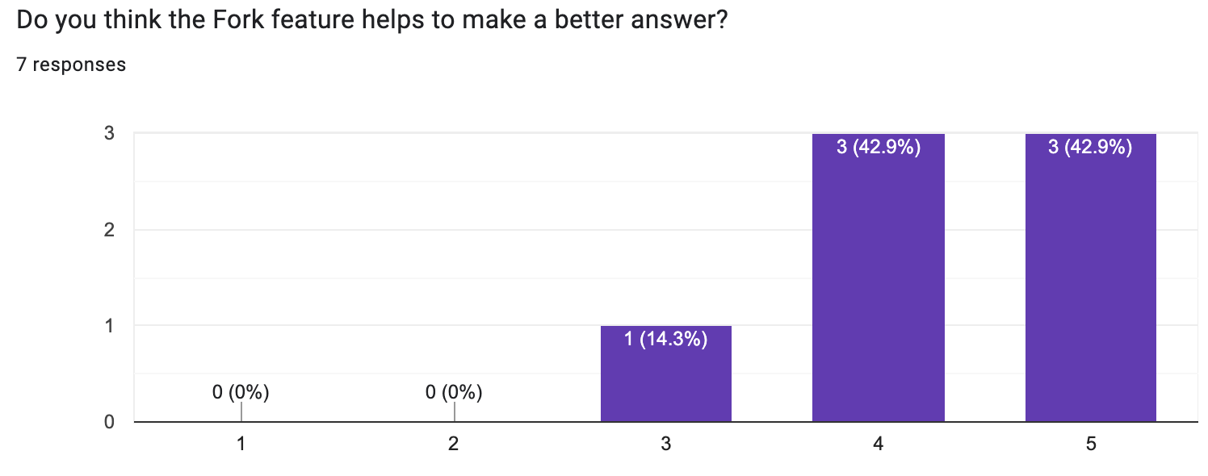
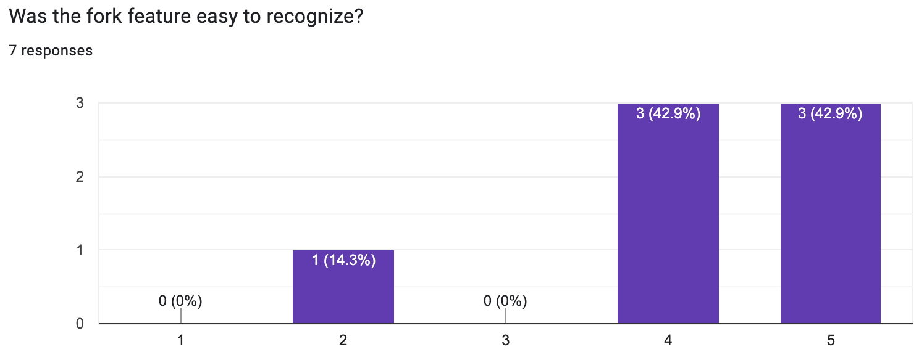
User Test Analysis
Q3. Impression of Fork Count
“As such, the prompt gave the impression that it was more effective in achieving the desired result. It was thought to be an indicator like the number of citations in the paper.”
“It stands out first among the answers, and I think it can also function like LIKE, HEART on other community sites.”
Q4. Ease of Recognizing Fork Feature
Q5. Helpfulness of Fork Feature

Slide 21
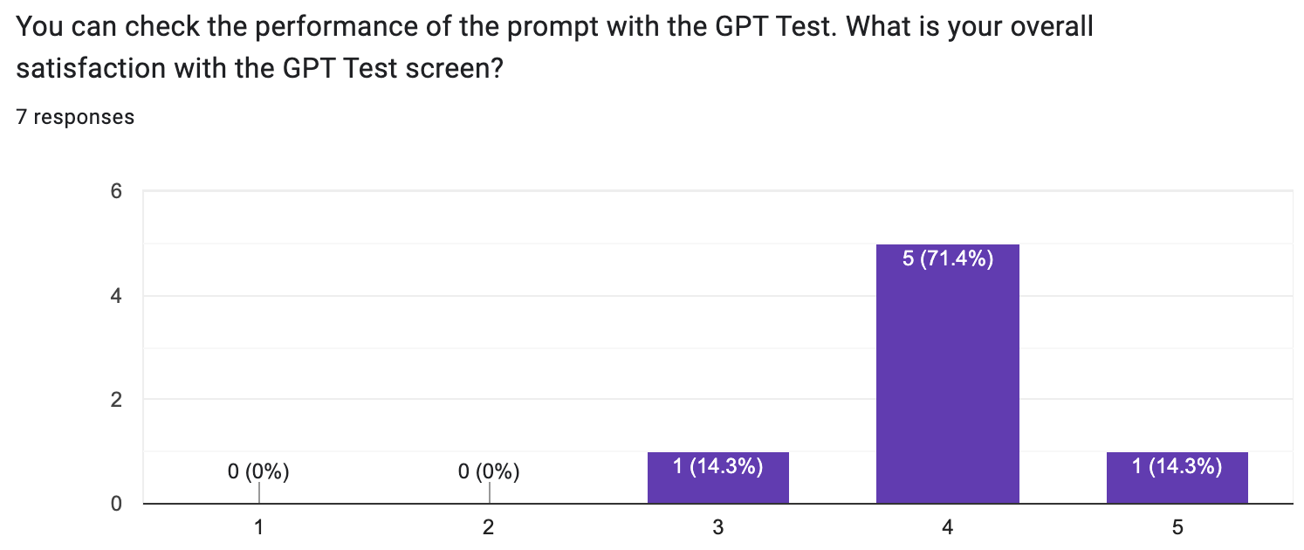
User Test Analysis
Q6. Satisfaction of GPT Test UI
Q7. Overall Review of <PromptCrowd>
“I think it's a good way to get a better answer with the power of collective intelligence if you can only gather enough users.
“As the crowdsourcing service, I think it is better to adopt more feature to encourage user participation and ensure the quality of answers.”
“First-time LLM users might not know how to type in to get the answers they want, so it would be helpful for these people.”

Slide 22
Discussion
Quality of Question
It was meaningful to write and specify example questions and expected answers on the screen of writing questions. All survey responses are positive to specify example questions and expected answer.
Fork Feature
This feature was used as intended in the demo. Users changed the prompts a little bit, or helped to change the parameters a little bit. This confirmed that fork feature was suitable for prompt engineering. It was also positive in the user survey.
The UI that exposed the ‘fork count’ also worked as intended. Some users mentioned ‘citation count of paper' in the survey. The fork count served to show some credibility in the answer, and encouraged users to read the answer first.

Slide 23
Discussion
Disappointed
- There was a lack of UI/UX. There were cases where components were slightly indistinguishable or convenient experience was not possible. I was able to get reports about such inconvenience by the user survey.
In particular, there was a user survey opinion that it was difficult to recognize the fork button even though fork function was a core function of this demo. This UI will need to be improved.
- It was able to check that crowdsourcing worked, but there was a lack of a system to trigger crowdsourcing. In crowdsourcing, evaluation and reward are very important. I didn't have the ability to build a user system properly. If the user system could have been created properly, personalized statistics or rewards could have been considered.
In addition, there was no direct evaluation to measure the quality of answers or questions. Fork count indirectly plays this role, but it would have been helpful if there was a more direct 'Like' system.

Slide 24
Discussion
Overall
Our challenge:
to develop a crowdsourcing solution that makes users to collaboratively identify and refine prompt statements
that enhance the performance and usability of LLMs.
There are points that need to be improved, but I can learn that crowdsourcing is one of the proper approaches for prompt engineering.
It was also a project where I could learn a lot about crowdsourcing services and serverless architecture.

Slide 25
References
Slide 2 Image https://www.ultimate.ai/blog/ai-automation/chatgpt-the-tech-behind-the-hype-and-what-it-means-for-your-support
Slide 3 Image https://botpenguin.com/glossary/prompt-engineering
Slide 9 Image https://react.dev/, https://medium.com/@dugguRK/understanding-real-time-firebase-database-in-android-eec9967745c8, https://vercel.com/home

